Slide 1
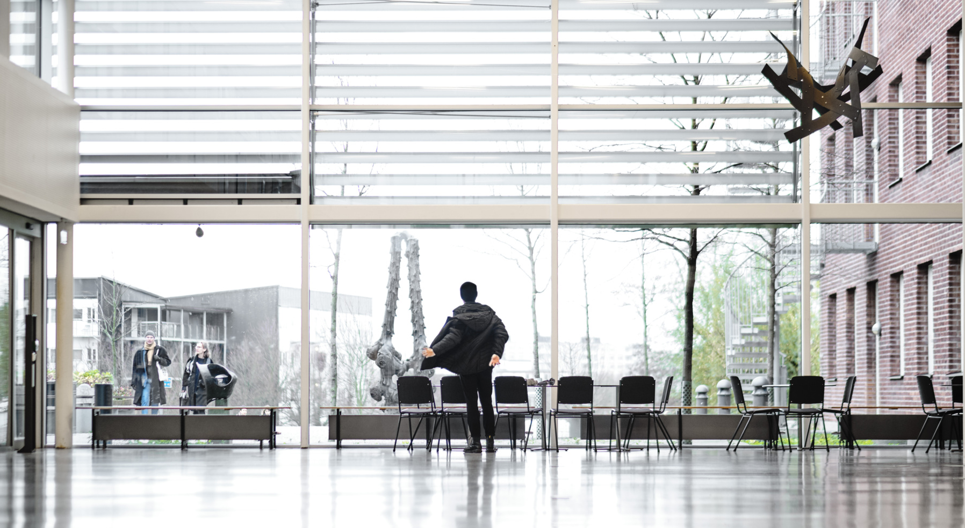
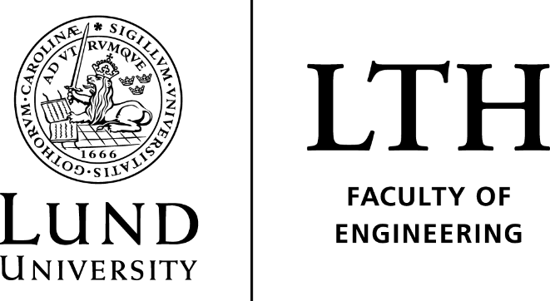
Deep Distributed learning for auto facial recognition
“Overview/Summary”
- Nikhil Challa & Simon Erlandsson

Slide 2
High level objectives
Use images collected from IoT device (camera OV7675)
Train a subset of images, using supervised learning but in a distributed fashion
Test/Validate on a new set of images and verify if classification is accurate.

Slide 3
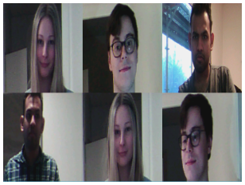
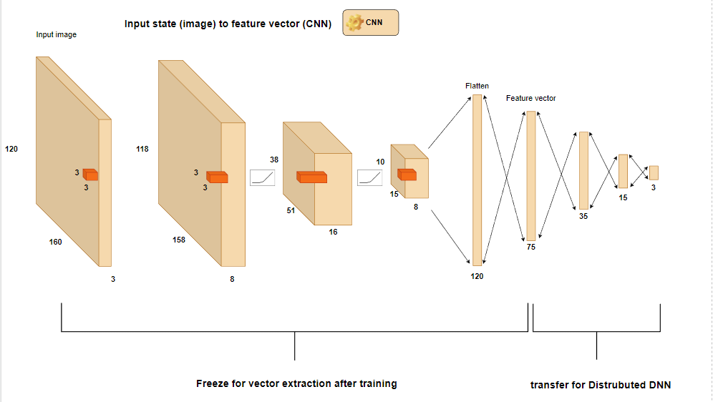
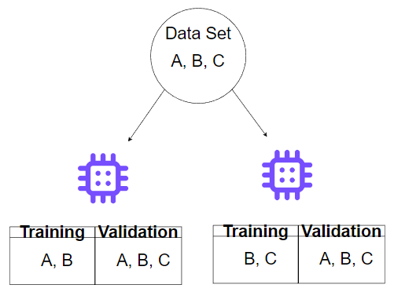
Sequence of steps – 1/2
Collect images (e.g., Label: A, B, C)
Train and validate the classification problem using python/TensorFlow.
Extract “feature” vectors (node value) for each data sample and store them on IoT Devices
Training data consists of partial labels.

Slide 4
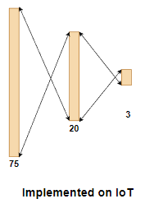
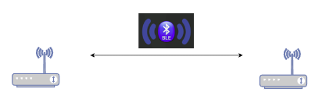
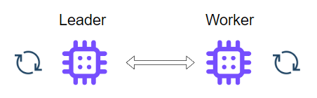
Sequence of steps – 2/2
Implement a simple Deep Neural Network model using C on IoT Device
Implement wireless communication between IoT Devices using Bluetooth.
Train using Deep Distributed learning and verify results on validation data

Slide 5
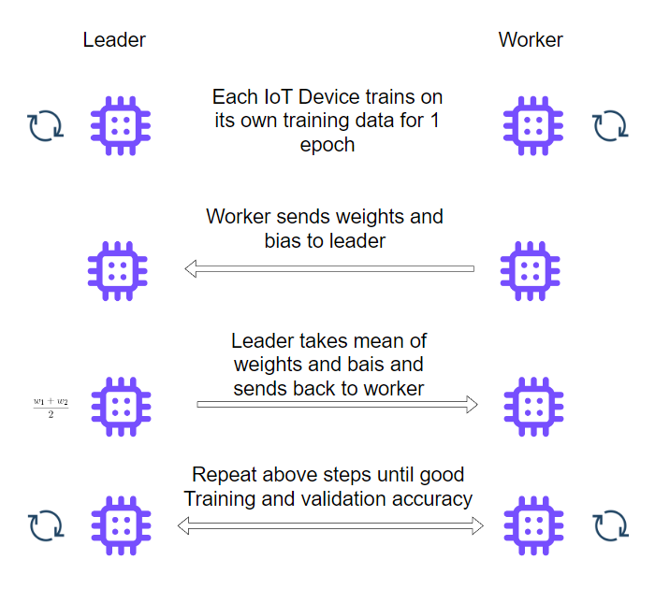
Distributed Deep Learning

Slide 6
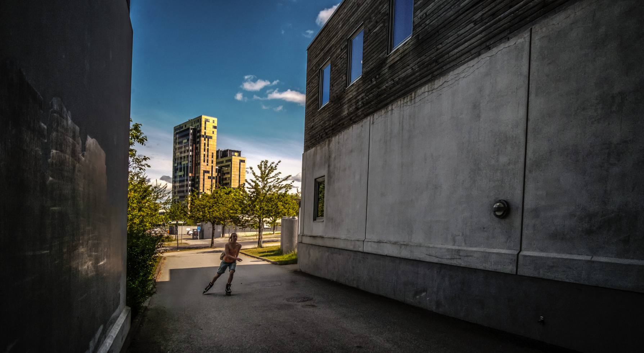
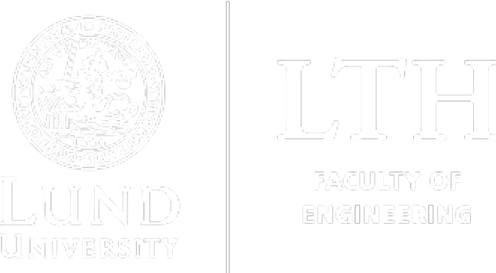
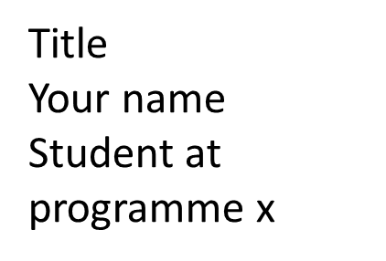
Thank you!

